Slide 1
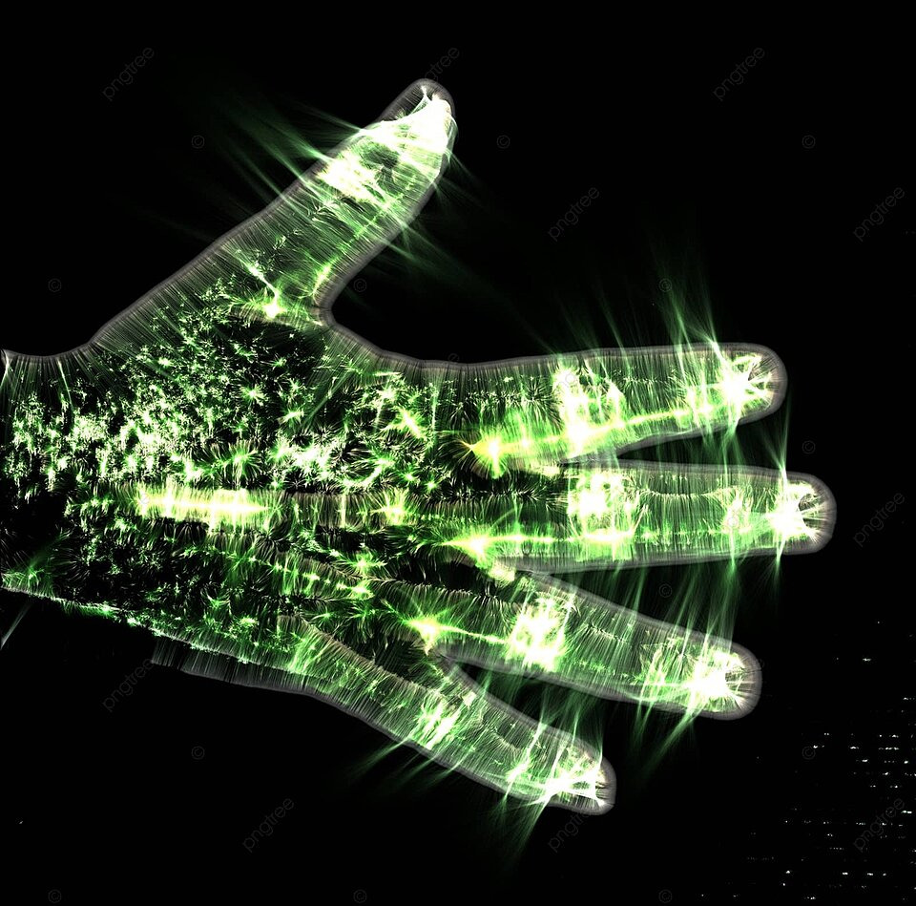
Hand Gesture Controlled Presentation
Submitted By:
Md Akhlak – 22SCE1011888
Abu Shahma Ansari – 22SCSE1011888
Course: B.Tech
Submitted To:
Dr Ashish Sharma
Associate Professor, DoCSE

Slide 2
Table of Contents
Introduction 7
Literature Survey 8
Implementation Results 10
System Design 12
Conclusion 13
Future Work
References 13

Slide 3
Introduction
WHAT IS HAND GESTURE CONTROL
Hand gesture control is an innovative technology that allows users to interact with devices using hand movements, providing a more natural and intuitive interface.
Hand gesture control involves using sensors and algorithms to detect and interpret human hand movements. These gestures are then converted into commands that can control devices or software.

Slide 4
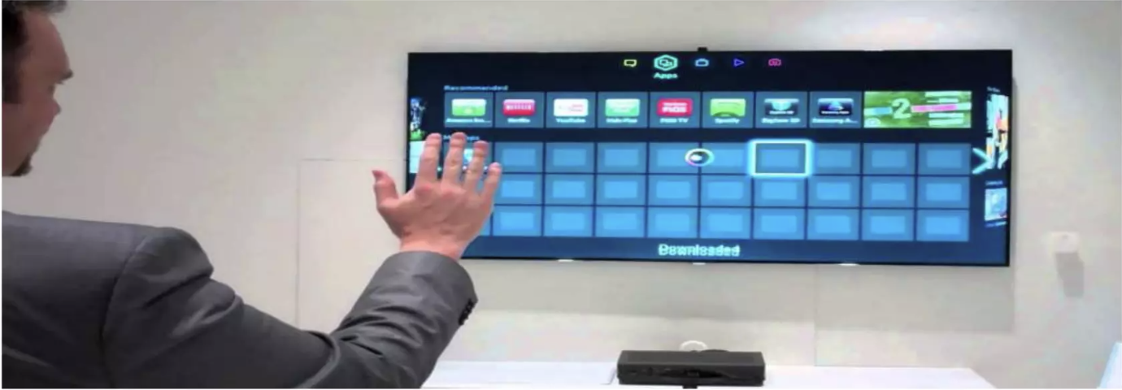
EXAMPLE
A smart TV recognizing the hand movements to control the channels or to select a option from the menu

Slide 5
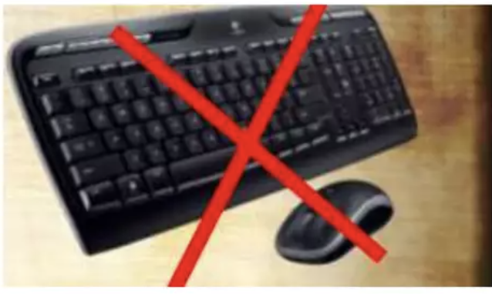
BENEFITS OF GESTURE RECOGNITION
A human computer interface can be provided using gestures
Replace mouse and keyboard
Pointing gestures
Navigate in a virtual environment
Interact with the 3D world

Slide 6
APPLICATIONS OF GESTURE CONTROL
One of the primary applications is in virtual reality, where users can interact with virtual environments more naturally.
This technology is also used in robotics, enabling operators to control robots remotely with simple hand movements.

Slide 7
LITERATURE SURVEY
Advanced hand motion recognition using Finger Earth Mover's Distance (FEMD).
Methods like Kalman filter and skin color detection for slides.
SVM for precise hand gesture identification.
OpenCV and TensorFlow for obstruction detection using webcams.
Mediapipe utilized in various studies for hand gesture recognition, enhancing the accuracy and efficiency of gesture-based presentation systems.

Slide 8
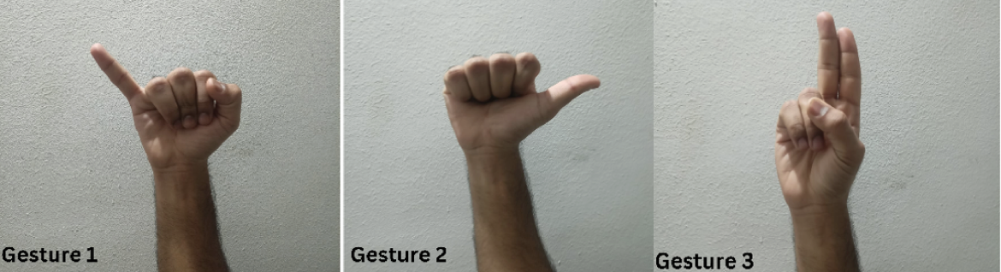
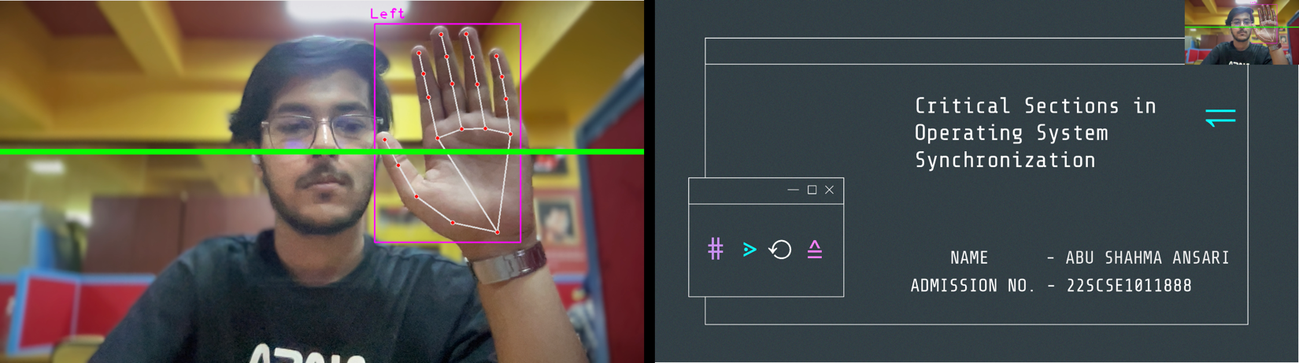
IMPLEMENTATION RESULTS
Figure 1
Block diagram
Figure 2
Trained Gesture

Slide 9
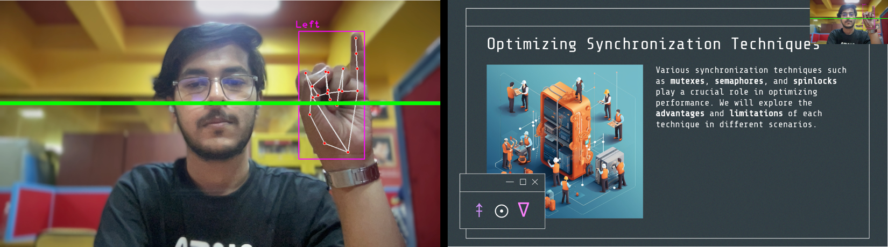
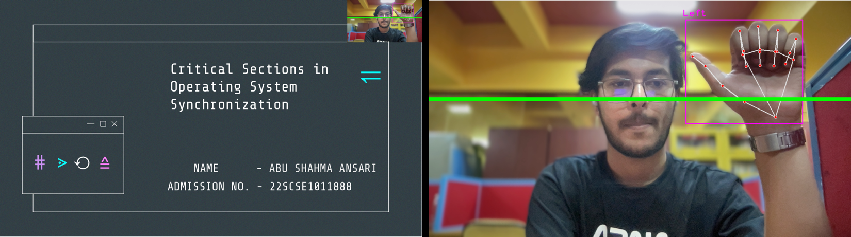
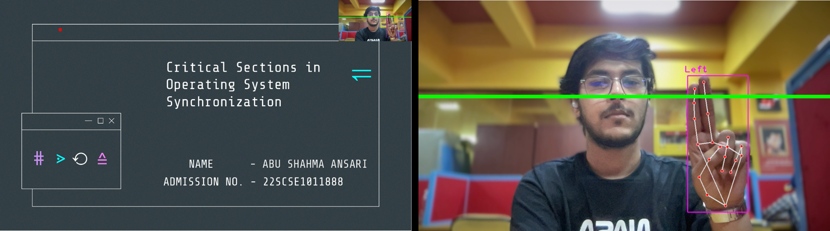
IMPLEMENTATION RESULTS
Figure 3
Next Slide
Figure 4
Previous Slide
Figure 5
Show Pointer

Slide 10
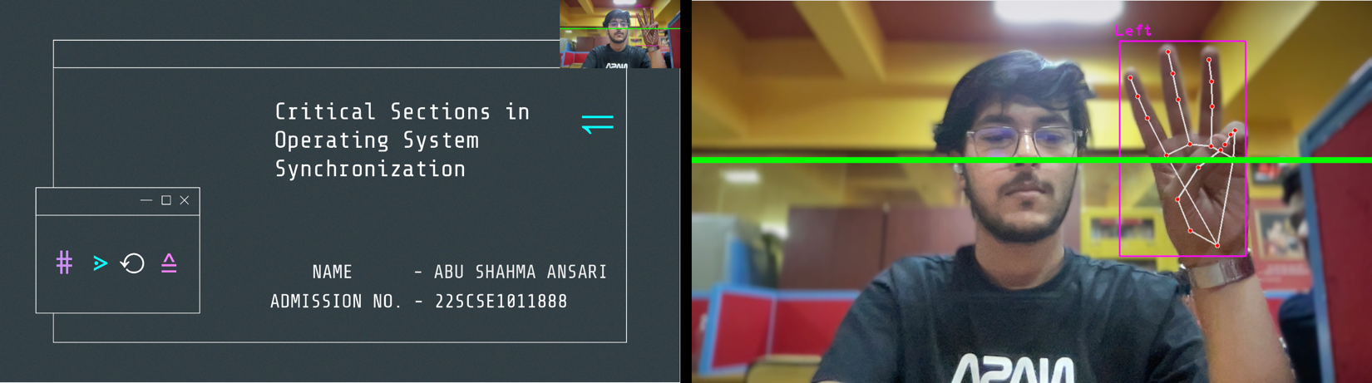
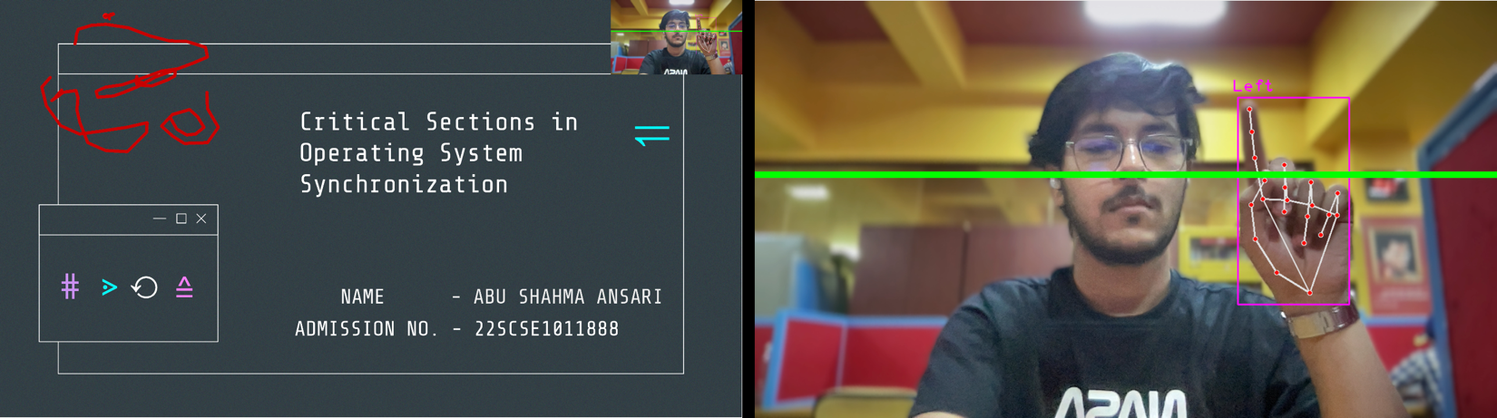
IMPLEMENTATION RESULTS
Figure 6
Drawing Pointer
Figure 7
Erasing previous Drawing

Slide 11
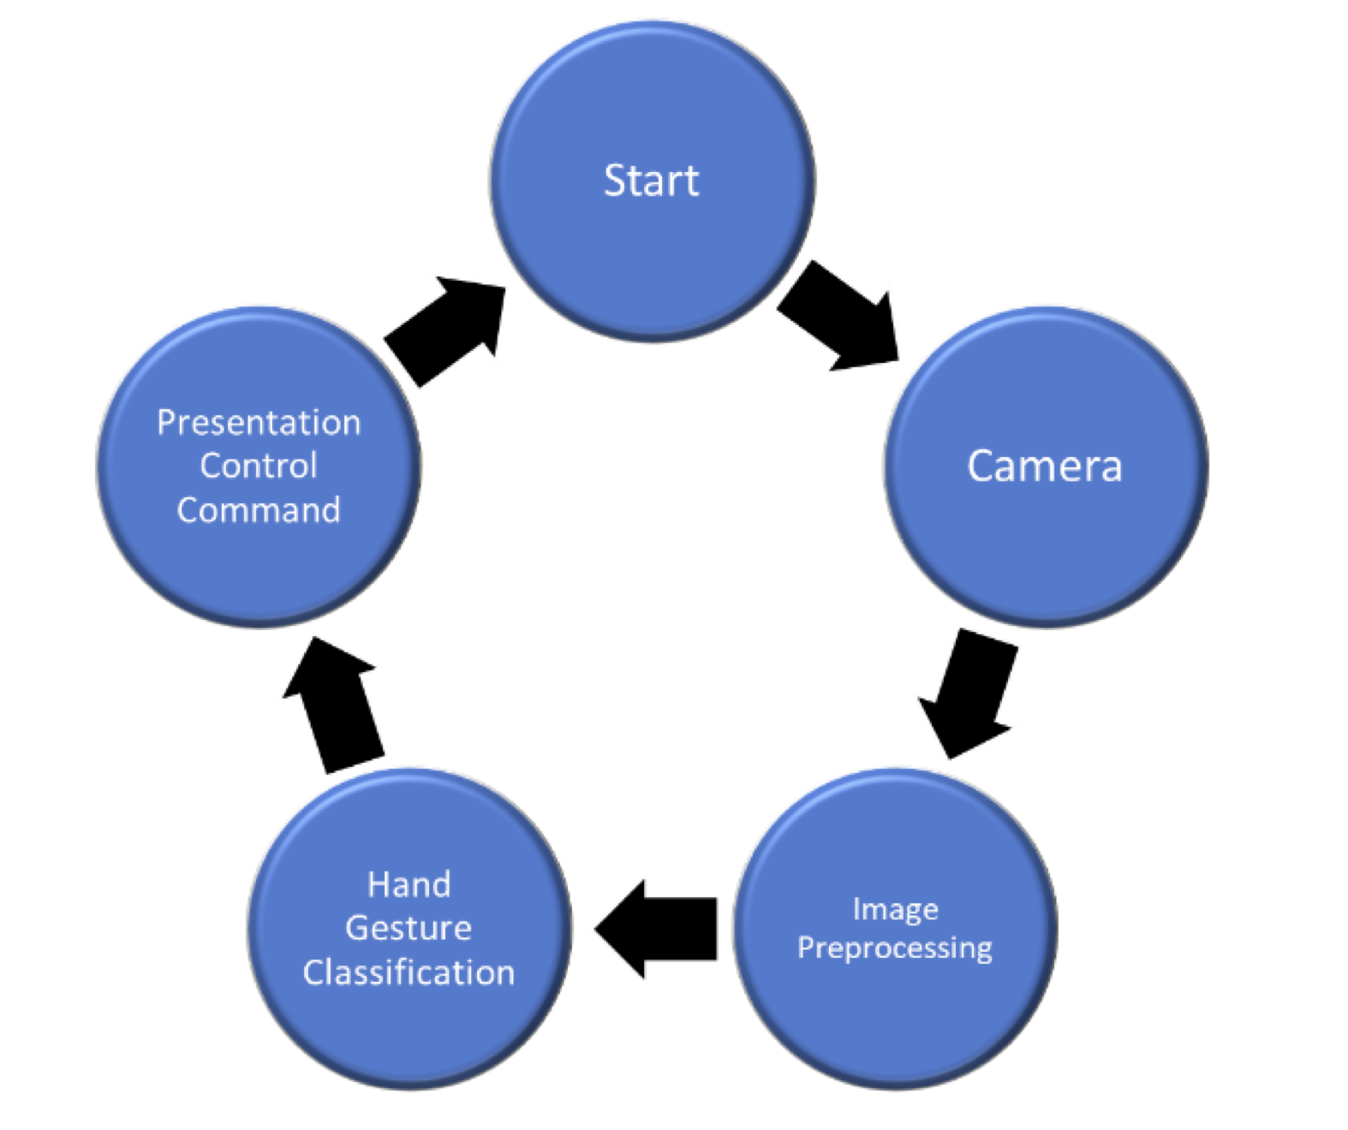
SYSTEM DESIGN

Slide 12
CONCLUSION
As technology continues to evolve, we can expect hand gesture control to become more prevalent and sophisticated, opening up new possibilities for various applications.

Slide 13
FUTURE WORK
Despite its advantages, hand gesture control technology faces challenges such as accuracy, latency, and environmental interferences.
Future developments will likely focus on improving the robustness of gesture recognition, minimizing errors, and expanding the range of recognizable gestures.
Integration with artificial intelligence and machine learning can also enhance the adaptability and precision of these systems.

Slide 14
THANK YOU..

